Slide 1

UNIT III COMBINATIONAL LOGIC CIRCUITS
II YEAR
AIML, BDA

Slide 2








CONTENTS
Quine-McCluskey minimization technique,
Combinational Circuits ,
Magnitude Comparator,
Read Only Memory,
Arithmetic Logic Unit,
Programmable Logic Arrays,
HDL Gate and Data Flow modeling ,
HDL Behavioral modeling
Multiplexer, Demultiplexer,
Decoder, Encoder,
Binary adder , Binary adder as subtractor, Carry look ahead adder, Decimal adder,

Slide 3
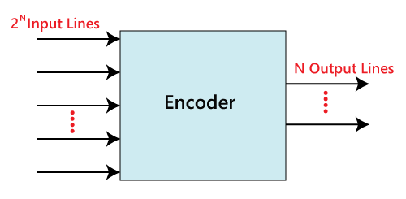
ENCODER
The combinational circuits that change the binary information into N output lines are known as Encoders.
The binary information is passed in the form of 2^{N} input lines.
The output lines define the N-bit code for the binary information. In simple words, the Encoder performs the reverse operation of the Decoder.
At a time, only one input line is activated for simplicity.
The produced N-bit output code is equivalent to the binary information.

Slide 4
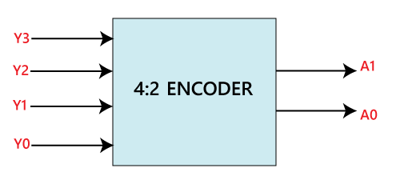
In 4 to 2 line encoder, there are total of four inputs, i.e., Y₀, Y₁, Y₂, and Y₃, and two outputs, i.e., A₀ and A₁.
In 4-input lines, one input-line is set to true at a time to get the respective binary code in the output side.
Below are the block diagram and the truth table of the 4 to 2 line encoder.
4 to 2 line Encoder:

Slide 5
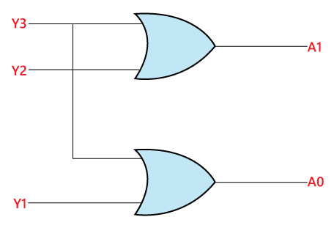
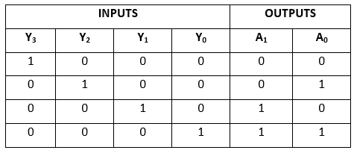
4 to 2 line Encoder:
The logical expression of the term A0 and A1 is as follows:
A₁=Y₃+Y₂ A₀=Y₃+Y₁
Logical circuit of the above expressions is given for reference:

Slide 6
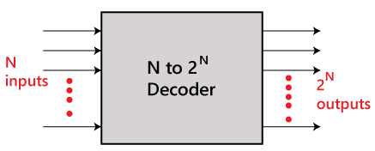
Decoder
The combinational circuit that change the binary information into 2^{N} output lines is known as Decoders.
The binary information is passed in the form of N input lines.
The output lines define the 2^{N}-bit code for the binary information. In simple words, the Decoder performs the reverse operation of the Encoder.
At a time, only one input line is activated for simplicity. The produced 2^{N}-bit output code is equivalent to the binary information.

Slide 7

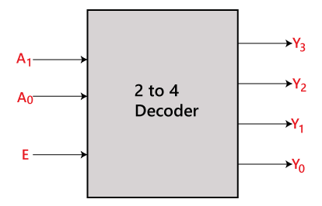


2 to 4 line decoder:
In the 2 to 4 line decoder, there is a total of three inputs, i.e., A₀, and A₁ and E and four outputs, i.e., Y₀, Y₁, Y₂, and Y₃.
For each combination of inputs, when the enable 'E' is set to 1, one of these four outputs will be 1.
The block diagram and the truth table of the 2 to 4 line decoder are given below.

Slide 8
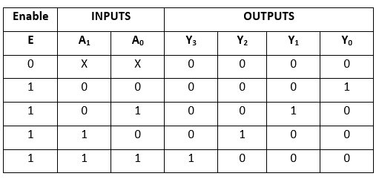
2 to 4 line decoder:
The logical expression of the term Y0, Y0, Y2, and Y3 is as follows:
Y₃=E.A₁.A₀ Y₂=E.A₁.A₀' Y₁=E.A₁'.A₀ Y0=E.A₁'.A₀'

Slide 9
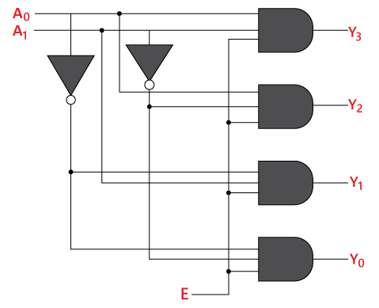
2 to 4 line decoder:

Slide 10
CONTENTS
Quine-McCluskey minimization technique,
Combinational Circuits ,
Magnitude Comparator,
Read Only Memory,
Arithmetic Logic Unit,
Programmable Logic Arrays,
HDL Gate and Data Flow modeling ,
HDL Behavioral modeling
Multiplexer, Demultiplexer,
Decoder, Encoder,
Binary adder , Binary adder as subtractor, Carry look ahead adder, Decimal adder,

Slide 11
Binary Adder
The registers play an important role in performing the micro-operations.
The registers hold the digital component and the data which performs the arithmetic operation.
The Binary Adder is a logical circuit which is used to perform the addition operation of two binary number of any length.
The Binary Adder is formed with the help of the Full-Adder circuit.
The Full-Adders are connected in series, and the output carry of the first Adder will be treated as the input carry of the next Full-Adder.

Slide 12
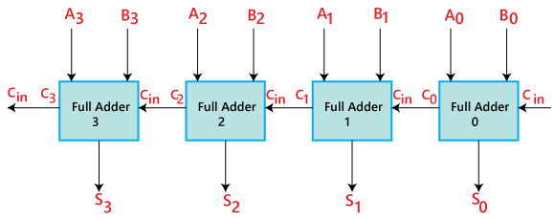
4-bit Binary Adder

Slide 13






4-bit Binary Adder
The 'A' and 'B' are the augend, and addend bits are defined by the subscript numbers. The subscripts start from right to left, and the lower-order bit is defined by subscript '0'.
The C0, C1, C2, and C3 are the carry inputs which are connected together as a chain using Full Adder. The C4 is the carry output produced by the last Full-Adder.
The C_{out} of the first Adder is connected as the C_{in} of the next Full-Adder.
The S0, S1, S2, and S3 are the sum outputs that produce the sum of augend and addend bits.
The inputs for the input variable 'A' and 'B' are fetched from different source registers. For example, the bit for the input variable 'A' comes from register 'R1', and a bit for the input variable 'B' comes from register 'R2'.
The outcome produced by adding both input variables is stored into either third register or to one of the source registers.

Slide 14
Binary Adder-Subtractor
A Binary Adder-Subtractor is a special type of circuit that is used to perform both operations, i.e., Addition and Subtraction.
The operation which is going to be used depends on the values contained by the control signal.
In Arithmetic Logical Unit, it is one of the most important components.
To work with Binary Adder-Subtractor, it is required that we have knowledge of the XOR gate, Full-Adder, Binary Addition, and subtraction.
For example, we will take two 4-bit binary numbers 'X' and 'Y' for the operation with digits.
X₀ X₁ X₂ X₃ for X Y₀ Y₁ Y₂ Y₃ for Y

Slide 15
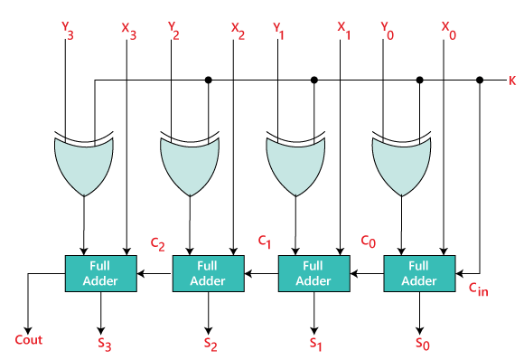
Binary Adder-Subtractor
The Binary Adder-Subtractor is a combination of 4 Full-Adder, which is able to perform the addition and subtraction of 4-bit binary numbers.
The control line determines whether the operation being performed is either subtraction or addition.
This determination is done by the binary values 0 and 1, which is hold by K.

Slide 16
Example
We assume that we have two 3 bit numbers, i.e., X=100 and Y=011, and feed them in Full-Adder as an input.
X₀ = 0 X₁ = 0 X₂ = 1
Y₀ = 1 Y₁ = 1 & Y₂ = 0
For K=0:
Y₀⨁K=Y₀ and C_{in}=K=0
So, from first Full-Adder
S₀ = X₀+Y₀+C_{in}
S₀= 0+1+0
S₀=1
C₀=0
Similarly,
S₁ = X₁+Y₁+C₀ S₁ = 0+1+0 S₁=1 and C₁=0
Similarly,
S₂ = X₂+Y₂+C₁ S₂ = 1+0+0 S₂=1 and C₂=0
Thus,
X= 100 =4 Y = 011 = 3 Sum = 0111 = 7

Slide 17
Example
For K=1
Y₀⨁K=Y₀' and C_{in}=k=1
So,
S₀ = X₀+Y₀'+C_{in} S₀ = 0+0+1 S₀=1 and C₀=0
Similarly,
S₁ = X₁+Y₁'+C₀ S₁ = 0+0+0 S₁=0 and C₁=0
Similarly,
S₂ = X₂+Y₂'+C₁ S₂ = 1+1+0 S₂=0 and C₂=0
Thus,
X = 010 = 4 Y = 011 = 3
Difference = 001 = 1

Slide 18
CONTENTS
Quine-McCluskey minimization technique,
Combinational Circuits ,
Magnitude Comparator,
Read Only Memory,
Arithmetic Logic Unit,
Programmable Logic Arrays,
HDL Gate and Data Flow modeling ,
HDL Behavioral modeling
Multiplexer, Demultiplexer,
Decoder, Encoder,
Binary adder , Binary adder as subtractor, Carry look ahead adder, Decimal adder,

Slide 19
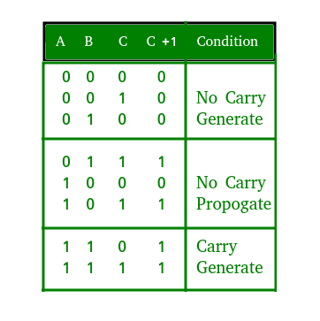
Carry Look Ahead Adder
A carry look-ahead adder reduces the propagation delay by introducing more complex hardware.
In this design, the ripple carry design is suitably transformed such that the carry logic over fixed groups of bits of the adder is reduced to two-level logic.

Slide 20
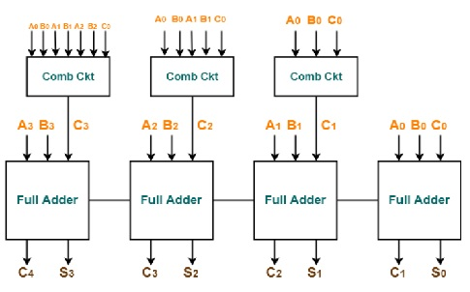
4-Bit Carry Look-ahead Adder
In this adder, the carry input at any stage of the adder is independent of the carry bits generated at the independent stages.
Here the output of any stage is dependent only on the bits which are added in the previous stages and the carry input provided at the beginning stage.
Hence, the circuit at any stage does not have to wait for the generation of carry-bit from the previous stage and carry bit can be evaluated at any instant of time.

Slide 21
Truth Table of Carry Look-ahead Adder
For deriving the truth table of this adder, two new terms are introduced – Carry generate and carry propagate.
Carry generate Gi =1 whenever there is a carry Ci+1 generated. It depends on Ai and Bi inputs. Gi is 1 when both Ai and Bi are 1.
Hence, Gi is calculated as Gi = Ai. Bi.
Carry propagated Pi is associated with the propagation of carry from Ci to Ci+1. It is calculated as Pi = Ai ⊕ Bi.
The truth table of this adder can be derived from modifying the truth table of a full adder.
Using the Gi and Pi terms the Sum Si and Carry Ci+1 are given as below –
Si = Pi ⊕ Gi.
Ci+1 = Ci.Pi +Gi.

Slide 22

4-Bit Carry Look-ahead Adder
Therefore, the carry bits C1, C2, C3, and C4 can be calculated as
C1 = C0.P0+G0.
C2 = C1.P1+G1 = ( C0.P0+G0).P1+G1.
C3 = C2.P2+G2 = (C1.P1+G1).P2+G2.
C4 = C3.P3+G3 = C0.P0.P1.P2.P3 + P3.P2.P1.G0 + P3.P2.G1 + G2.P3 + G3.
It can be observed from the equations that carry Ci+1 only depends on the carry C0, not on the intermediate carry bits.

Slide 23
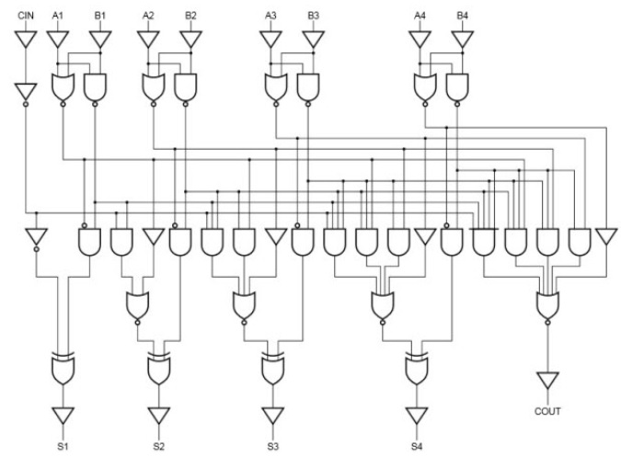
4-bit-Carry-Look-ahead-Adder-Circuit-Diagram

Slide 24
Advantages of Carry Look-ahead Adder
In this adder, the propagation delay is reduced.
The carry output at any stage is dependent only on the initial carry bit of the beginning stage.
Using this adder it is possible to calculate the intermediate results.
This adder is the fastest adder used for computation.

Slide 25
Applications
High-speed Carry Look-ahead Adders are used as implemented as IC’s. Hence, it is easy to embed the adder in circuits.
By combining two or more adders calculations of higher bit boolean functions can be done easily.
Here the increase in the number of gates is also moderate when used for higher bits.
For this Adder there is a tradeoff between area and speed.
When used for higher bit calculations, it provides high speed but the complexity of the circuit is also increased thereby increasing the area occupied by the circuit.
This adder is usually implemented as 4-bit modules which are cascaded together when used for higher calculations. This adder is costlier compared to other adders.

Slide 26
CONTENTS
Quine-McCluskey minimization technique,
Combinational Circuits ,
Magnitude Comparator,
Read Only Memory,
Arithmetic Logic Unit,
Programmable Logic Arrays,
HDL Gate and Data Flow modeling ,
HDL Behavioral modeling
Multiplexer, Demultiplexer,
Decoder, Encoder,
Binary adder , Binary adder as subtractor, Carry look ahead adder, Decimal adder,

Slide 27
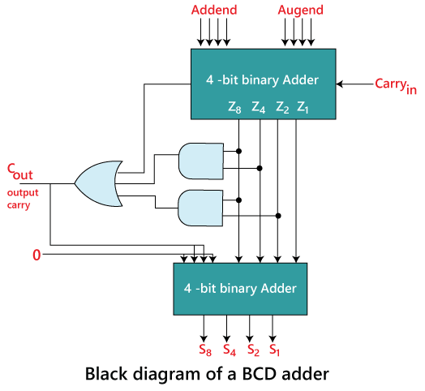
Decimal or BCD Adder
The BCD-Adder is used in the computers and the calculators that perform arithmetic operation directly in the decimal number system.
The BCD-Adder accepts the binary-coded form of decimal numbers.
The Decimal-Adder requires a minimum of nine inputs and five outputs.

Slide 28
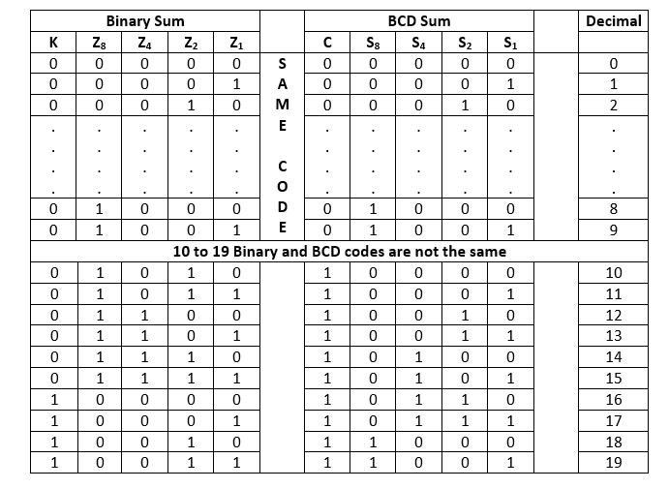
Truth Table

Slide 29
BCD Adder
From the above table, it is clear that if the produced sum is between 1 to 9, the Binary and the BCD code is the same. But for 10 to 19 decimal numbers, both the codes are different. In the above table, the binary sum combinations from 10 to 19 give invalid BCD. There are the following points that help the circuit to identify the invalid BCD.
It is obvious from the table that a correction is needed when the 'Binary Sum' has an output carry K=1.
The other six combinations from 10 to 15 need correction in which the bit on the Z₈ position is 1.
In the Binary sum of 8 and 9, the bit on the Z₈ position is also 1. So, the second step fails, and we need to modify it.
To distinguish these two numbers, we specify that the bit on the Z₄ or Z₂ position also needs to be 1 with the bit of Z₈
The condition for a correction and an output carry can be expressed by the Boolean function:
C=K+Z₈.Z₄+Z₈.Z₂
Once the circuit found the invalid BCD, the circuit adds the binary number of 6 into the invalid BCD code to make it valid.

Slide 30
Decimal Adder
We take a 4-bit Binary-Adder, which takes addend and augend bits as an input with an input carry 'Carry in'.
The Binary-Adder produces five outputs, i.e., Z8, Z4, Z2, Z1, and an output carry K.
With the help of the output carry K and Z8, Z4, Z2, Z1 outputs, the logical circuit is designed to identify the C_{out}
The Z8, Z4, Z2, and Z1 outputs of the binary adder are passed into the 2nd 4-bit binary adder as an Augend.
The addend bit of the 2nd 4-bit binary adder is designed in such a way that the 1st and the 4th bit of the addend number are 0 and the 2nd and the 3rd bit are the same as C_{out}.
When the value of C_{out} is 0, the addend number will be 0000, which produce the same result as the 1st 4-bit binary number.
But when the value of the C_{out} is 1, the addend bit will be 0110, i.e., 6, which adds with the augent to get the valid BCD number.

Slide 31
Example: 1001+1000
First, add both the numbers using a 4-bit binary adder and pass the input carry to 0.
The binary adder produced the result 0001 and carried output 'K' 1.
Then, find the C_{out} value to identify that the produced BCD is invalid or valid using the expression C_{out}=K+Z₈.Z₄+Z₈.Z₂. K = 1 Z₈ = 0 Z₄ = 0 Z₂ = 0 C_{out} = 1+0*0+0*0 C_{out} = 1+0+0 C_{out} = 1
The value of C_{out} is 1, which expresses that the produced BCD code is invalid. Then, add the output of the 1st 4-bit binary adder with 0110. = 0001+0110 = 0111
The BCD is represented by the carry output as: BCD=C_{out} Z₈ Z₄ Z₂ Z₁=1 0 1 1 1

Slide 32
CONTENTS
Quine-McCluskey minimization technique,
Combinational Circuits ,
Magnitude Comparator,
Read Only Memory,
Arithmetic Logic Unit,
Programmable Logic Arrays,
HDL Gate and Data Flow modeling ,
HDL Behavioral modeling
Multiplexer, Demultiplexer,
Decoder, Encoder,
Binary adder , Binary adder as subtractor, Carry look ahead adder, Decimal adder,

Slide 33
Magnitude Comparator
A Comparator is a combinational circuit that gives output in terms of A>B, A<B, and A=B.
This is entirely expected from the name.
A digital comparator’s purpose is to compare numbers and represent their relationship with each other.

Slide 34
1-bit Comparator
A | B | A>B | A<B | A=B
0 | 0 | 0 | 0 | 1
0 | 1 | 0 | 1 | 0
1 | 0 | 1 | 0 | 0
1 | 1 | 0 | 0 | 1

Slide 35
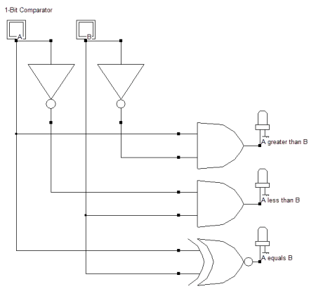
1-BIT COMPARATOR
X(which stands for A>B) = AB’
Y (A<B )= A’B
Z (A=B)= A’B’ + AB
This is similar to the equation of an EXNOR gate. Hence,

Slide 36
CONTENTS
Quine-McCluskey minimization technique,
Combinational Circuits ,
Magnitude Comparator,
Read Only Memory,
Arithmetic Logic Unit,
Programmable Logic Arrays,
HDL Gate and Data Flow modeling ,
HDL Behavioral modeling
Multiplexer, Demultiplexer,
Decoder, Encoder,
Binary adder , Binary adder as subtractor, Carry look ahead adder, Decimal adder,

Slide 37
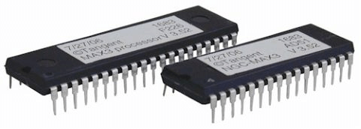
Read Only Memory
ROM, which stands for read only memory, is a memory device or storage medium that stores information permanently.
It is also the primary memory unit of a computer along with the random-access memory (RAM).
It is called read only memory as we can only read the programs and data stored on it but cannot write on it.
It is restricted to reading words that are permanently stored within the unit.
The manufacturer of ROM fills the programs into the ROM at the time of manufacturing the ROM.
After this, the content of the ROM can't be altered, which means you can't reprogram, rewrite, or erase its content later.
However, there are some types of ROM where you can modify the data.

Slide 38
ROM
ROM contains special internal electronic fuses that can be programmed for a specific interconnection pattern (information).
The binary information stored in the chip is specified by the designer and then embedded in the unit at the time of manufacturing to form the required interconnection pattern (information).
Once the pattern (information) is established, it stays within the unit even when the power is turned off.
So, it is a non-volatile memory as it holds the information even when the power is turned off, or you shut down your computer.
The information is added to a RAM in the form of bits by a process known as programming the ROM as bits are stored in the hardware configuration of the device. So, ROM is a Programmable Logic Device (PLD).

Slide 39
ROM - EXAMPLE
When you start your computer, the screen does not appear instantly.
It takes time to appear as there are startup instructions stored in ROM which are required to start the computer during the booting process.
The work of the booting process is to start the computer. It loads the operating system into the main memory (RAM) installed on your computer.
The BIOS program, which is also present in the computer memory (ROM) is used by the microprocessor of the computer to start the computer during the booting process.
It allows you to open the computer and connects the computer with the operating system.
ROM is also used to store Firmware, which is a software program which remains attached to the hardware or programmed on a hardware device like a keyboard, hard drive, video cards, etc.
It is stored in the flash ROM of a hardware device. It provides instructions to the device to communicate and interact with other devices.

Slide 40
Types of ROM:
1) Masked Read Only Memory (MROM):
It is a hardware memory device in which programs and instructions are stored at the time of manufacturing by the manufacturer. So it is programmed during the manufacturing process and can't be modified, reprogrammed, or erased later.
2) Programmable Read Only Memory (PROM):
PROM is a blank version of ROM. It is manufactured as blank memory and programmed after manufacturing. We can say that it is kept blank at the time of manufacturing. You can purchase and then program it once using a special tool called a programmer.
Uses: It is used in cell phones, video game consoles, medical devices, RFID tags, and more.

Slide 41
Types of ROM:
3) Erasable and Programmable Read Only Memory (EPROM):
EPROM is a type of ROM that can be reprogramed and erased many times. The method to erase the data is very different; it comes with a quartz window through which a specific frequency of ultraviolet light is passed for around 40 minutes to erase the data. So, it retains its content until it is exposed to the ultraviolet light. You need a special device called a PROM programmer or PROM burner to reprogram the EPROM.
Uses: It is used in some micro-controllers to store program, e.g., some versions of Intel 8048 and the Freescale 68HC11.
4) Electrically Erasable and Programmable Read Only Memory (EEPROM):
ROM is a type of read only memory that can be erased and reprogrammed repeatedly, up to 10000 times. It is also known as Flash EEPROM as it is similar to flash memory. It is erased and reprogrammed electrically without using ultraviolet light. Access time is between 45 and 200 nanoseconds.
Uses: The BIOS of a computer is stored in this memory.

Slide 42
Types of ROM:
5) FLASH ROM:
It is an advanced version of EEPROM. It stores information in an arrangement or array of memory cells made from floating-gate transistors. The advantage of using this memory is that you can delete or write blocks of data around 512 bytes at a particular time. Whereas, in EEPROM, you can delete or write only 1 byte of data at a time. So, this memory is faster than EEPROM.
It can be reprogrammed without removing it from the computer. Its access time is very high, around 45 to 90 nanoseconds. It is also highly durable as it can bear high temperature and intense pressure.
Uses: It is used for storage and transferring data between a personal computer and digital devices. It is used in USB flash drives, MP3 players, digital cameras, modems and solid-state drives (SSDs). The BIOS of many modern computers are stored on a flash memory chip, called flash BIOS.

Slide 43
CONTENTS
Quine-McCluskey minimization technique,
Combinational Circuits ,
Magnitude Comparator,
Read Only Memory,
Arithmetic Logic Unit,
Programmable Logic Arrays,
HDL Gate and Data Flow modeling ,
HDL Behavioral modeling
Multiplexer, Demultiplexer,
Decoder, Encoder,
Binary adder , Binary adder as subtractor, Carry look ahead adder, Decimal adder,

Slide 44
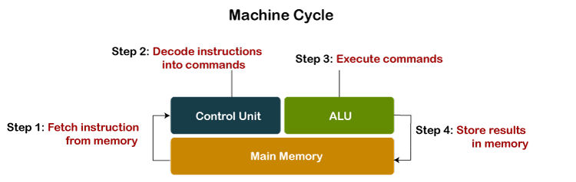
ARITHMETIC LOGIC UNIT
In the computer system, ALU is a main component of the central processing unit, which stands for arithmetic logic unit and performs arithmetic and logic operations.
It is also known as an integer unit (IU) that is an integrated circuit within a CPU or GPU, which is the last component to perform calculations in the processor.
It has the ability to perform all processes related to arithmetic and logic operations such as addition, subtraction, and shifting operations, including Boolean comparisons (XOR, OR, AND, and NOT operations)

Slide 45
The operations performed by ALU are:
Logical Operations: The logical operations consist of NOR, NOT, AND, NAND, OR, XOR, and more.
Bit-Shifting Operations: It is responsible for displacement in the locations of the bits to the by right or left by a certain number of places that are known as a multiplication operation.
Arithmetic Operations: Although it performs multiplication and division, this refers to bit addition and subtraction. But multiplication and division operations are more costly to make. In the place of multiplication, addition can be used as a substitute and subtraction for division.

Slide 46
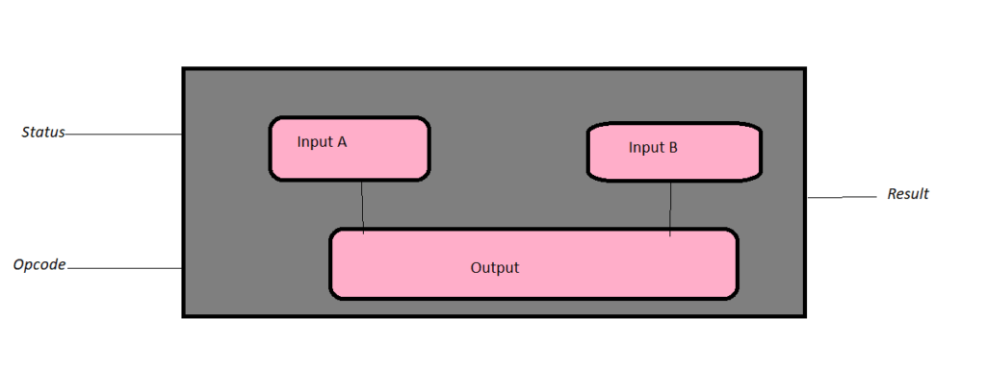
Arithmetic Logic Unit (ALU) Signals

Slide 47
Arithmetic Logic Unit (ALU) Signals
ALU input gets signals from the external circuits, and in response, external electronics get outputs signals from ALU.
Data: Three parallel buses are contained by the ALU, which include two input and output operand. These three buses handle the number of signals, which are the same.
Opcode: When the ALU is going to perform the operation, it is described by the operation selection code what type of operation an ALU is going to perform arithmetic or logic operation.
Status
Output: The results of the ALU operations are provided by the status outputs in the form of supplemental data as they are multiple signals. Usually, status signals like overflow, zero, carry out, negative, and more are contained by general ALUs. When the ALU completes each operation, the external registers contained the status output signals. These signals are stored in the external registers that led to making them available for future ALU operations.
Input: When ALU once performs the operation, the status inputs allow ALU to access further information to complete the operation successfully. Furthermore, stored carry-out from a previous ALU operation is known as a single "carry-in" bit.

Slide 48

Configurations of the ALU
The description of how ALU interacts with the processor is given below. Every arithmetic logic unit includes the following configurations:
Instruction Set Architecture
Accumulator
Stack
Register to Register
Register Stack
Register Memory

Slide 49
Advantages of ALU
It supports parallel architecture and applications with high performance.
It has the ability to get the desired output simultaneously and combine integer and floating-point variables.
It has the capability of performing instructions on a very large set and has a high range of accuracy.
Two arithmetic operations in the same code like addition and multiplication or addition and subtraction, or any two operands can be combined by the ALU. For case, A+B*C.
Through the whole program, they remain uniform, and they are spaced in a way that they cannot interrupt part in between.
In general, it is very fast; hence, it provides results quickly.
There are no sensitivity issues and no memory wastage with ALU.
They are less expensive and minimize the logic gate requirements.

Slide 50
Disadvantages of ALU
With the ALU, floating variables have more delays, and the designed controller is not easy to understand.
The bugs would occur in our result if memory space were definite.
It is difficult to understand amateurs as their circuit is complex; also, the concept of pipelining is complex to understand.
A proven disadvantage of ALU is that there are irregularities in latencies.
Another demerit is rounding off, which impacts accuracy.

Slide 51
CONTENTS
Quine-McCluskey minimization technique,
Combinational Circuits ,
Magnitude Comparator,
Read Only Memory,
Arithmetic Logic Unit,
Programmable Logic Arrays,
HDL Gate and Data Flow modeling ,
HDL Behavioral modeling
Multiplexer, Demultiplexer,
Decoder, Encoder,
Binary adder , Binary adder as subtractor, Carry look ahead adder, Decimal adder,

Slide 52
Programmable Logic Devices
PLDs are the integrated circuits.
They contain an array of AND gates & another array of OR gates.
There are three kinds of PLDs based on the type of arrays, which has programmable feature.
Programmable Read Only Memory
Programmable Array Logic (PAL)
Programmable Logic Array(PLA)
The process of entering the information into these devices is known as programming.

Slide 53
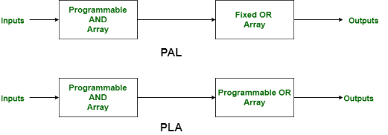
PAL AND PAL

Slide 54
PAL
PLA
While PAL stands for Programmable Array Logic.
While PAL’s speed is higher than PLA.
While PAL’s complexity is less.
While the cost of PAL is low.
While Programmable Array Logic is more available than Programmable Logic Array.
It is less used than PAL.
PLA stands for Programmable Logic Array.
PLA speed is lower than PAL.
The complexity of PLA is high.
The cost of PLA is also high.
Programmable Logic Array is less available.
While it is more used than PLA.

Slide 55
Programmable Logic Arrays
Programmable Logic Array(PLA) is a fixed architecture logic device with programmable AND gates followed by programmable OR gates.
PLA is basically a type of programmable logic device used to build a reconfigurable digital circuit.
PLDs have an undefined function at the time of manufacturing, but they are programmed before made into use.
PLA is a combination of memory and logic.
PLA has programmable AND gate array and programmable OR gate array.
PAL has programmable AND gate array but fixed OR gate array.
ROM has fixed AND gate array but programmable OR gate array.
PLA is similar to a ROM in concept; however, it does not provide full decoding of variables and does not generate all minterms as in the ROM.

Slide 56
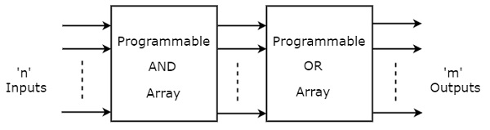
Programmable Logic Arrays
PLA is a programmable logic device that has both Programmable AND array & Programmable OR array.
Hence, it is the most flexible PLD.
The block diagram of PLA is shown in the following figure.

Slide 57
CONTENTS
Quine-McCluskey minimization technique,
Combinational Circuits ,
Magnitude Comparator,
Read Only Memory,
Arithmetic Logic Unit,
Programmable Logic Arrays,
HDL Gate and Data Flow modeling ,
HDL Behavioral modeling
Multiplexer, Demultiplexer,
Decoder, Encoder,
Binary adder , Binary adder as subtractor, Carry look ahead adder, Decimal adder,

Slide 58
HDL Modeling
Gate Level Modeling
Data flow modeling
Behavioral modeling
Structural modeling

Slide 59
Gate Level Modeling
In Verilog, most of the digital designs are done at a higher level of abstraction like RTL.
However, it becomes natural to build smaller deterministic circuits at a lower level by using combinational elements such as AND and OR.
Modeling done at this level is called gate-level modeling as it involves gates and has a one to one relationship between a hardware schematic and the Verilog code.
Verilog supports a few basic logic gates known as primitives, as they can be instantiated, such as modules, and they are already predefined.
Gate level modeling is virtually the lowest level of abstraction because the switch-level abstraction is rarely used.
Gate level modeling is used to implement the lowest-level modules in a design, such as multiplexers, full-adder, etc.

Slide 60
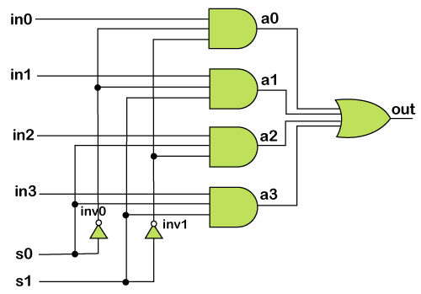
Gate Level Modeling of a 4:1 Multiplexer

Slide 61
module 4x1_mux (out, in0, in1, in2, in3, s0, s1);
// port declarations
output out; // Output port.
input in0, in1, in2. in3; // Input ports.
input s0, s1; // Input ports: select lines.
// intermediate wires
wire inv0, inv1; // Inverter outputs.
wire a0, a1, a2, a3; // AND gates outputs.
// Inverters.
not not_0 (inv0, s0);
not not_1 (inv1, s1);
// 3-input AND gates.
and and_0 (a0, in0, inv0, inv1);
and and_1 (a1, in1, inv0, s1);
and and_2 (a2, in2, s0, inv1);
and and_3 (a3, in3, s0, s1);
// 4-input OR gate.
or or_0 (out, a0, a1, a2, a3);
endmodule

Slide 62
Data Flow Modeling
Dataflow modeling makes use of the functions that define the working of the circuit instead of its gate structure.
Dataflow modeling has become a popular design approach, as logic synthesis tools became sophisticated.
This approach allows the designer to focus on optimizing the circuit in terms of the flow of data.
Dataflow modeling uses several operators that act on operands to produce the desired results.
Verilog provides about 30 operator types. Dataflow modeling describes hardware in terms of the flow of data from input to output.
The dataflow level shows the nature of the flow of data in continuous assignment statements (assign keyword).
It describes the combinational circuit by their functions rather than their gate structures.
For coding in the dataflow style, we only need to know about the logical expression of the circuit.

Slide 63
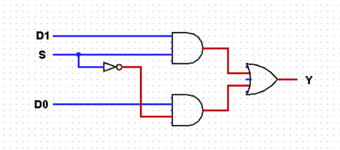
Gate Level Modeling of a 4:1 Multiplexer

Slide 64
The equation for 2:1 mux is:
Y = D0.S’ + D1.S
where Y is the final output, D0, D1, and S are inputs.
module m21(D0, D1, S, Y);
output Y;
input D0, D1, S;
assign Y=(S)?D1:D0;
endmodule

Slide 65
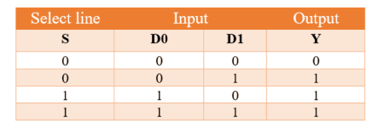
Behavioural Modeling
This level describes the behavior of a digital system.
In most of the cases, we code the behavioral model using the truth table of the circuit.
Now to find the expression, we will use K- map for final output Y.
Equation from the truth table: Y = D0.S’ + D1.S

Slide 66
Behavioral modeling mainly includes two statements:
An initial statement which is executed the only once
always statement, which is executed once the sensitivity list is activated.
You should notice that the output is equal to the second input if the select line is high. Otherwise, it is equal to the first input itself.
This logic can be stated by using the if-else statement.
Since the output of 2:1 MUX changes once there is a change in D0 OR D1 OR S we’ll use always statement.
Now, if the S event is true, the output Y will be D1, else the output will be D0.
Gate Level Modeling of a 4:1 Multiplexer

Slide 67
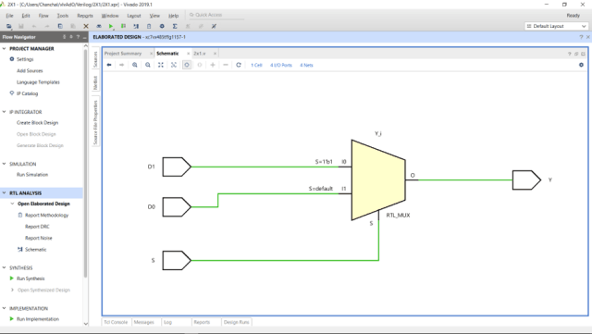
module m21( D0, D1, S, Y);
input wire D0, D1, S;
output reg Y;
always @(D0 or D1 or S) begin
if(S) Y= D1;
else Y=D0;
end
endmodule

Slide 68
UNIT III END
Next: UNIT IV - SEQUENTIAL CIRUITS

